Slide 1

Sales Performance & Growth Report
A comprehensive analysis of ₹4.29M revenue, identifying fulfillment bottlenecks, payment patterns, and strategic profit solutions.

Slide 2
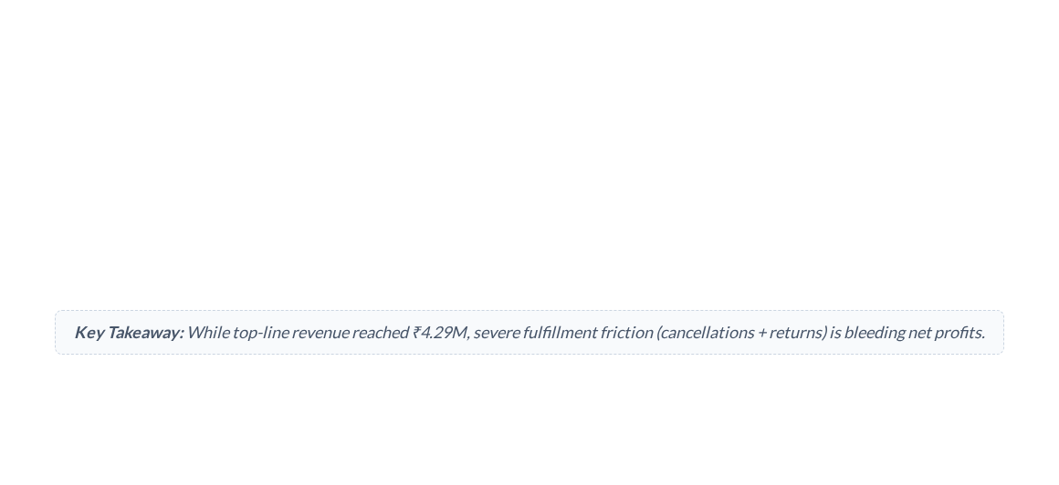



Executive Summary & Key KPIs
₹4.29M
439
1,000+
26%
TOTAL NET REVENUE
TOTAL ORDERS
UNITS SOLD
DELIVERY FULFILLMENT
Across 4 main product categories
Generated across 5 major states
Led by Electronics & Fashion
50% Returns & Cancellations

Slide 3
PART 1: The Core Business Problem
Analyzing order status metrics reveals major operational inefficiencies that hinder revenue realization.

Slide 4
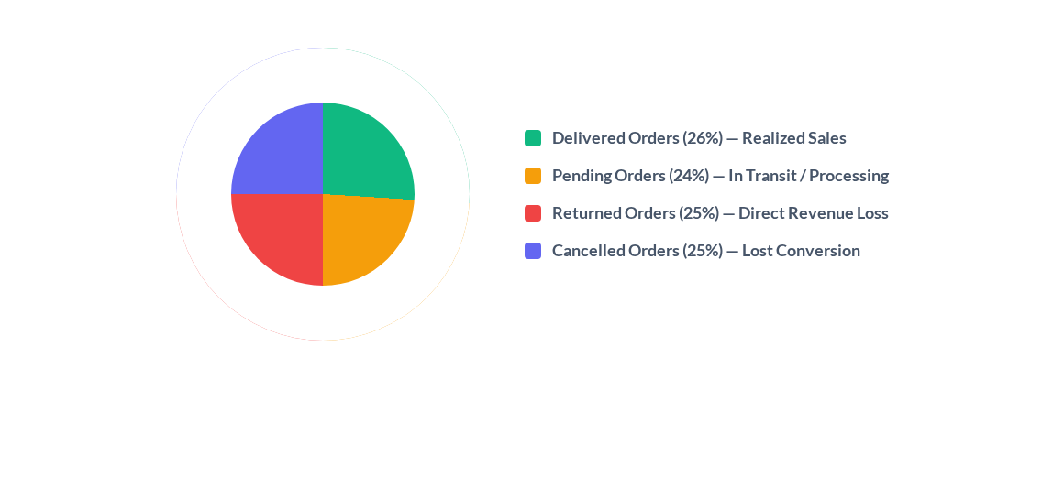
Critical Bottleneck: 50% Order Leakage

Slide 5
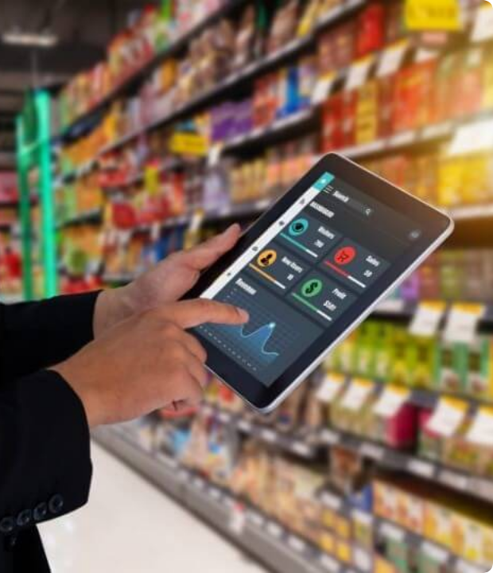

Why Are Orders Failing?
Root Cause Breakdown
1. Delivery Delays: Long transit timelines lead to high cancellation rates before dispatch.
2. COD & Payment Friction: Cash on Delivery (COD) accounts for 23% of orders and exhibits 3x higher return rates compared to prepaid modes.
Impact on Profitability
Every returned order costs up to 1.5x of shipping charges plus restocking fees, eroding product margins.

Slide 6
PART 2: Sales & Revenue Analysis
Evaluating revenue across product categories, monthly trends, regional hubs, and payment preferences.

Slide 7
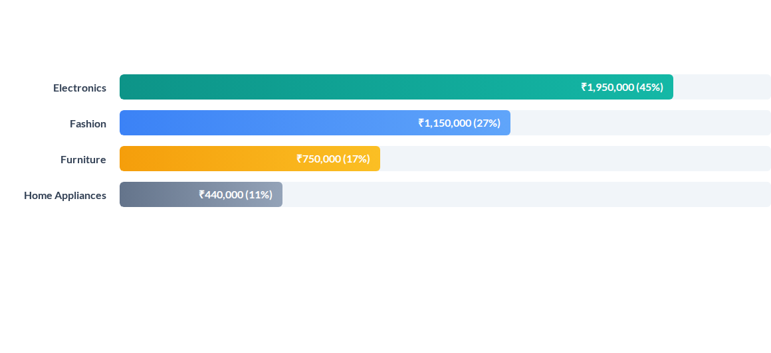
Revenue Distribution by Category

Slide 8
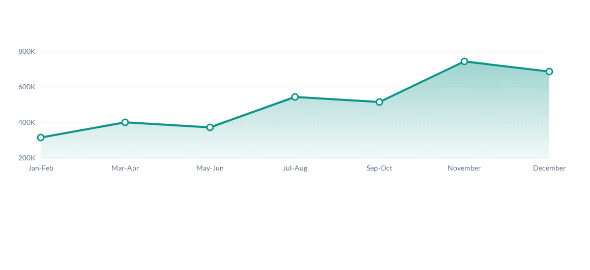
Monthly Sales Trend & Peak Demand

Slide 9
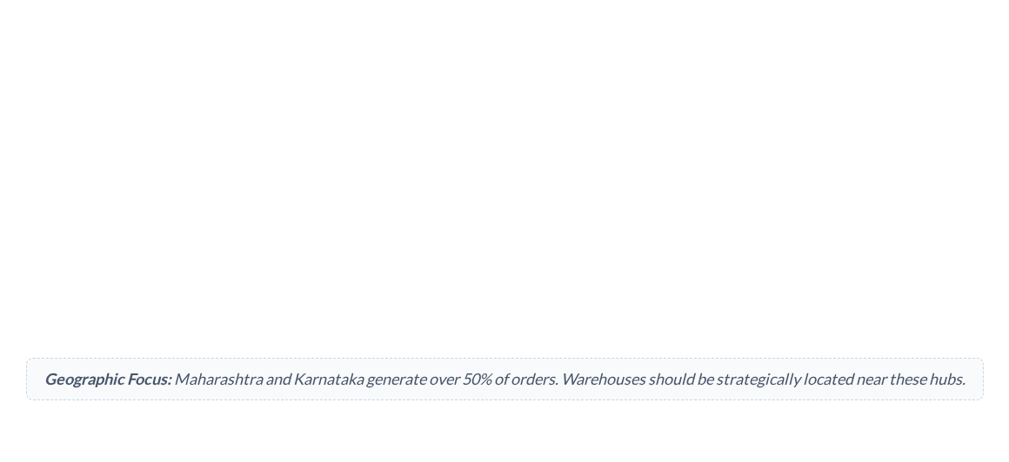
Top Products & High-Performing States
Top 5 Products | Category | Top State Markets | Revenue Contribution | Demand Level
Laptop | Electronics | Maharashtra | High (₹1.2M) | ★★★★★
Chair | Furniture | Karnataka | Medium (₹650K) | ★★★★☆
Watch | Fashion | Uttar Pradesh | Medium (₹520K) | ★★★★☆
Bottle | Home | Delhi | Moderate (₹310K) | ★★★☆☆
Mouse | Electronics | Rajasthan | Moderate (₹220K) | ★★★☆☆

Slide 10








Payment Preferences & Friction
Digital Wallets (23%)
COD (23%)
NetBanking (21%)
UPI & Cards (33%)
Popular in tier-2 cities but triggers high impulse returns (38% return rate). Requires verification before dispatch.
Steady usage for high-ticket items like Laptops. High conversion stability with under 5% cancellation rate.
UPI (18%) and Cards (15%) drive fast checkouts. Prepaid incentives can shift COD buyers to digital payment.
High adoption due to instant rewards. Low return rate (<10%). Highly preferred by frequent online shoppers.

Slide 11
PART 3: Business Recommendations
Actionable, high-impact strategies to reduce returns, boost order fulfillment, and increase total profit.

Slide 12
5 Steps to Increase Profit & Sales
Reduce Returns via OTP Verification for COD: Implement mandatory OTP confirmation for Cash on Delivery orders to eliminate fake/impulse orders and cut return rates from 25% down to under 10%.
Offer Incentives on Prepaid Payments: Give a 3%–5% instant discount for UPI and Wallet payments to shift customers away from COD, securing revenue upfront and reducing cancellation risk.
Optimize Regional Stocking in Top States: Stock high-demand items like Laptops and Chairs in local fulfillment centers across Maharashtra and Karnataka for faster 24-48 hour delivery.
Bundle High-Margin with Low-Demand Products: Bundle fast-selling items (Laptops/Watches) with slow-moving stock (Bottles/Mice) to increase Average Order Value (AOV) and clear inventory efficiently.
Capitalize on Q4 Seasonal Peak Demand: Scale up targeted ad spending and inventory 30 days prior to Q4 (Oct-Dec) to maximize revenue during peak consumer shopping windows.

Slide 13

Image Sources
https://shaoke.com/wp-content/uploads/2024/03/Random-Photos-Landscape-1.jpg
Source: shaoke.com

